Slide 1

SMART MEDICINE REMINDER AND VENDING MACHINE
SECOND INDIVIUAL MEETING: ALEXA AND RASPBERRY PI INTERFACING
INSTRUCTOR: Prof. Mike Aleshams
Student Name: Nishitha Kodur
Student ID: C0771813

Slide 2
Table of Contents
Introduction
Agenda of this interfacing
Role of Alexa device in the project
Software block diagram
Signing up and downloading Ngrok
Transferring the downloaded Ngrok to Raspberry pi
Installing Ngrok on Raspberry pi
Starting HTTP tunnel using Ngrok
Installing Flask-ask and Cryptography libraires
Signing up for Amazon developer account
Configuring the skills set
Coding the Raspberry pi using Python
Working of the interface
References

Slide 3
Introduction
To overcome the problem of forgetting to take medicines in elderly people, we came up with a 'SMART MEDICINE REMINDER AND VENDING MACHINE.
' It is an IoT device which reminds and dispenses medicine on time.
In this project , we design and develop a medicine reminder and vending machine using Amazon Alexa and Raspberry pi.
The machine saves dispense and alarm time, when it is time to dispense the medicine, the machine alarms the user and dispenses the medicine to the racks.

Slide 4
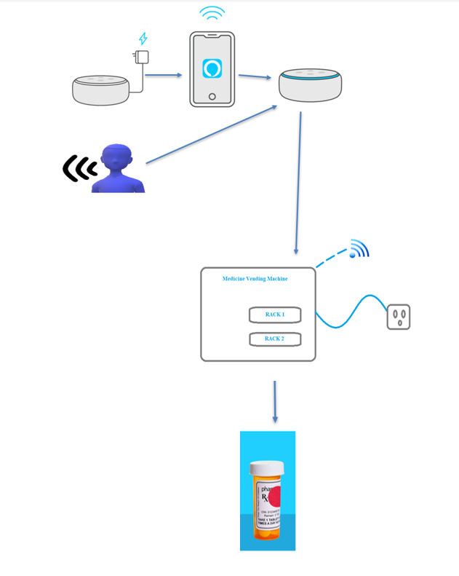
Introduction
Engineering Drawing:

Slide 5
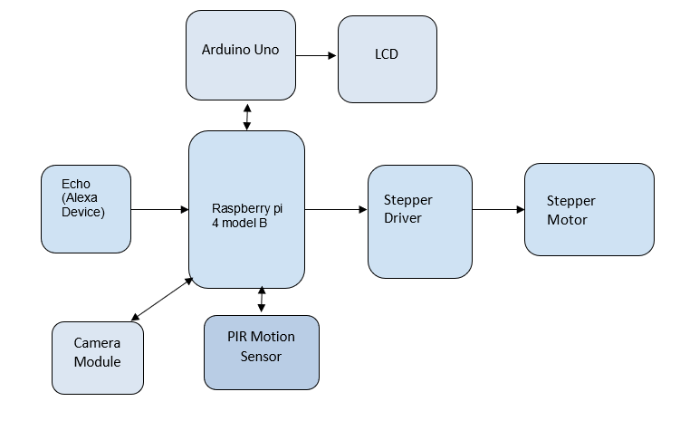
Introduction
Block Diagram:

Slide 6
Agenda of this interfacing
To design and test how the interface between Amazon Alexa Skills Kit and Raspberry pi works.
As raspberry pi server is not secure, Amazon server does not accept to interface with it. So, we are using a mediator which is Ngrok that helps in connecting these two servers.
For interfacing Raspberry pi and Alexa skills kit we are using python code as in C language we do not have the feature of measuring time.

Slide 7
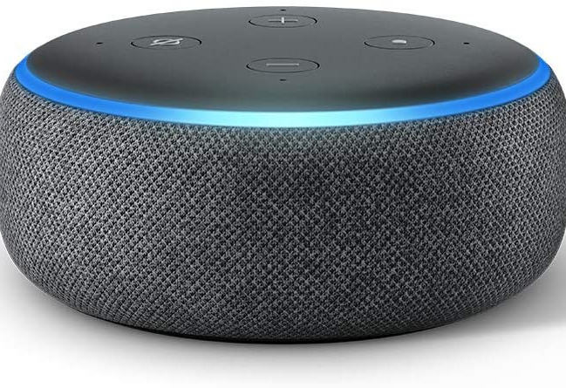
Role of Alexa device in the project
The main objective of using Alexa device in the project is to have voice interaction with the user. This feature helps older people to use this machine with ease.
Through voice commands we can set reminders about alarm time and medicine dispense time.
For e.g. After setting up the alarm time and dispense time, user can ask Alexa about when is the next alarm or dispense time and Alexa responds to the user with the information available.
For sending the alarm time and dispense time to Raspberry pi, we are planning to design a HTML page where the user or care taker will provide the information. This is to be done in Cloud Storage Management task.

Slide 8
Software block diagram
Ngork.com (mydomain.ngork.com)
Develop a new skill (amazon.com)
FIRE WALL
Raspberry pi:
Python CGIHTTP Server
Ngork client
Alexa Echo

Slide 9
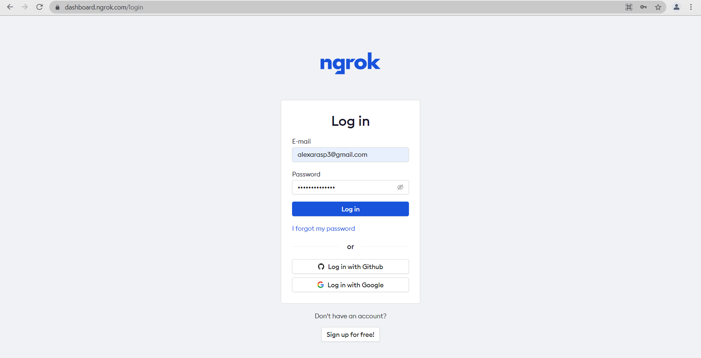
Signing up and downloading Ngrok
Go to the URL: https://dashboard.ngrok.com/login
Sign up using Google or GitHub account.

Slide 10
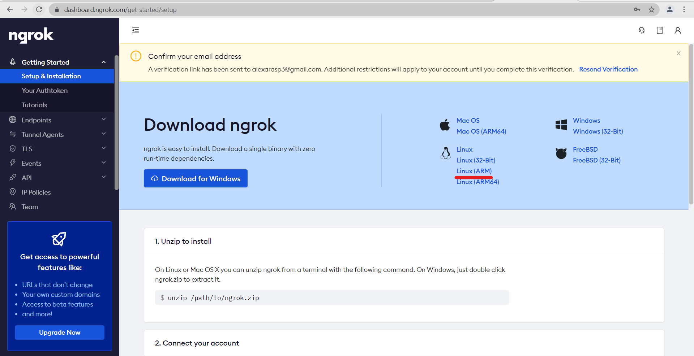
Signing up and downloading Ngrok
Navigated to dashboard after signing up/logging in.
Download ngrok for Linux(ARM).

Slide 11
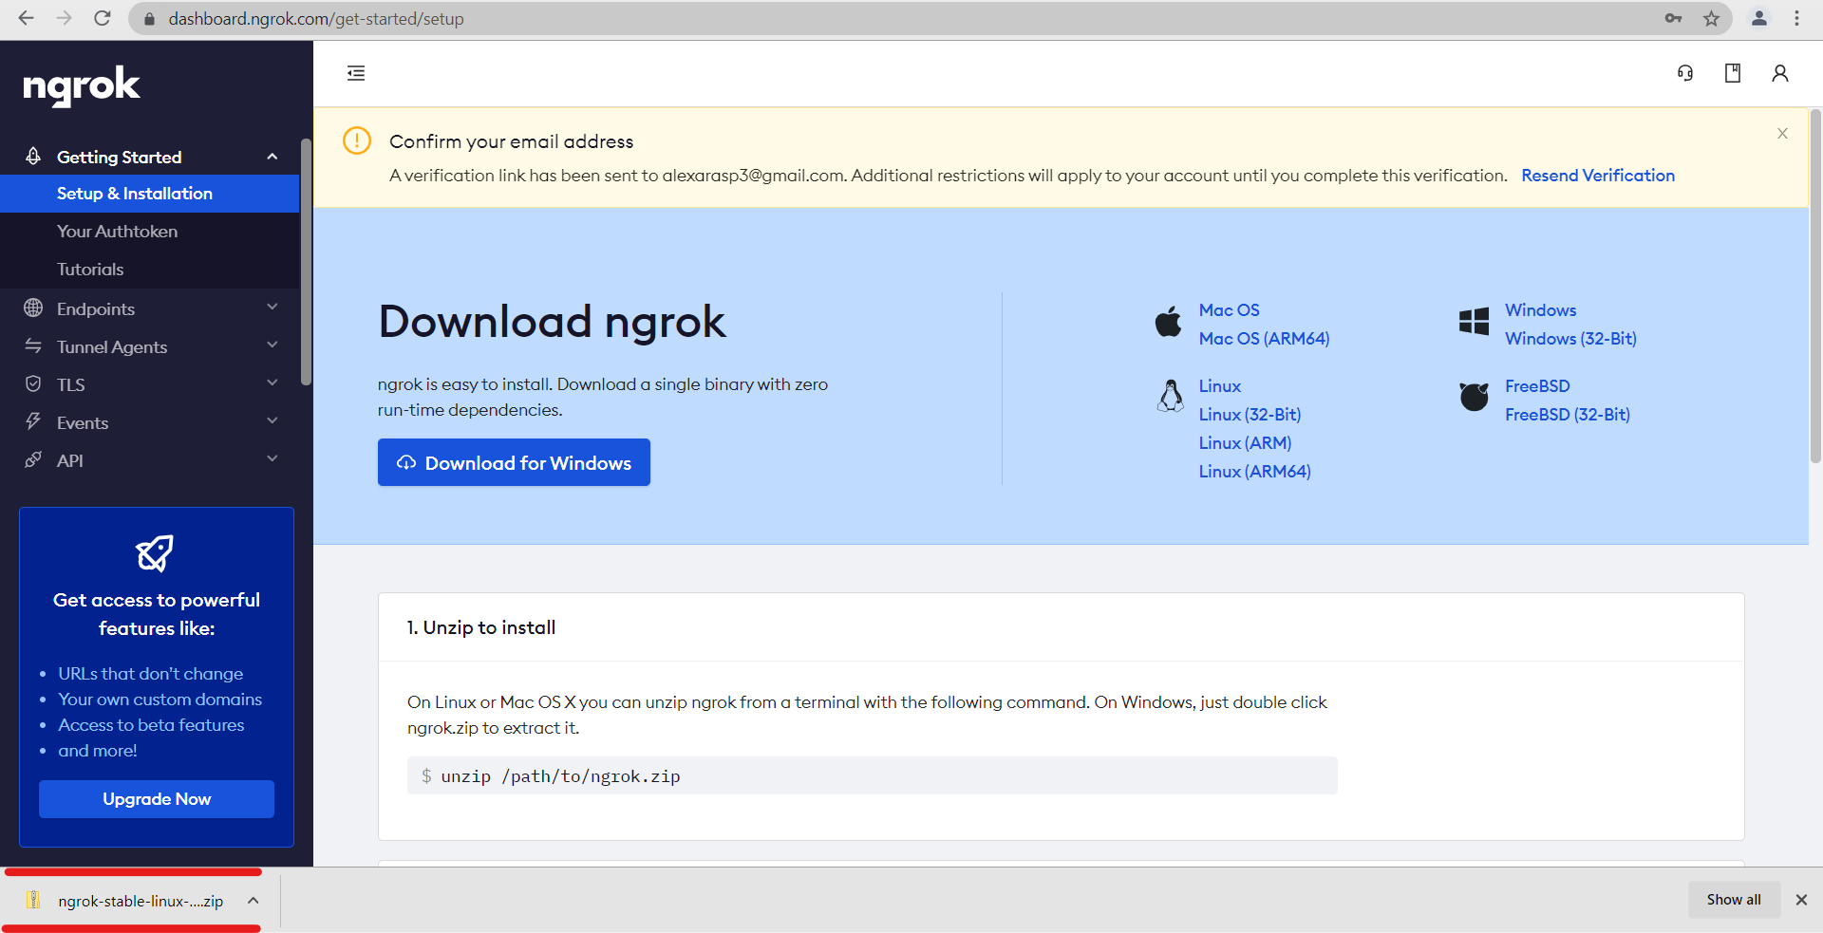
Signing up and downloading Ngrok
Zip file will be downloaded.

Slide 12
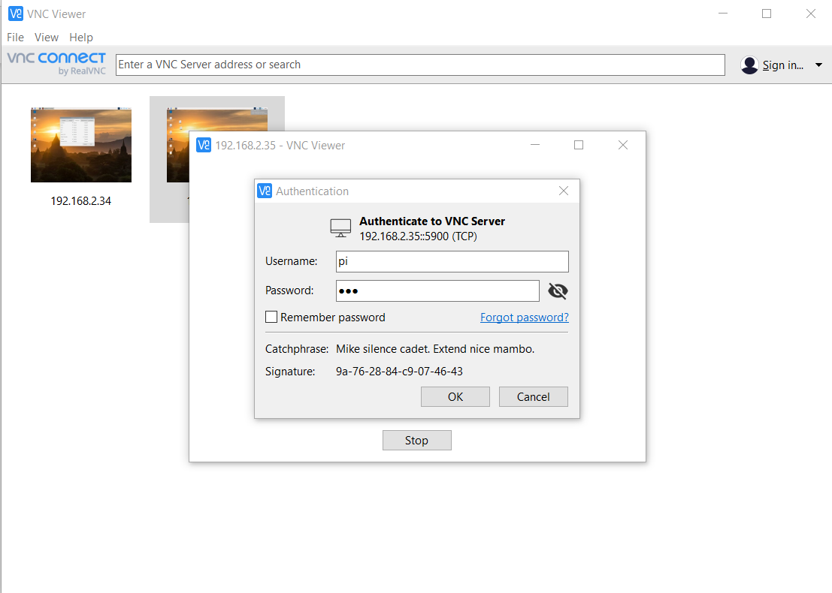
Transferring the downloaded Ngrok to Raspberry pi
Open VNC and connect to Raspberry pi IP address with username and password.

Slide 13
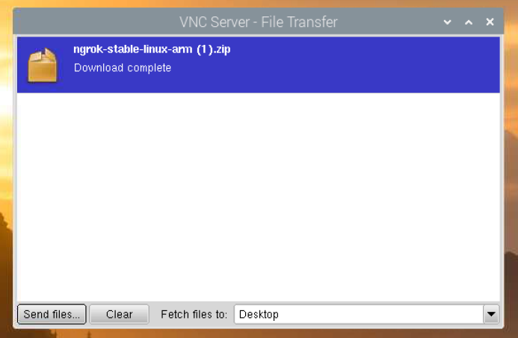
Transferring the downloaded Ngrok to Raspberry pi
Select Transfer files option available on top of the screen (in a hidden slider).
Next, click Send File. This displays the file manager of Windows OS. From here, go to the Downloads location where the zip file containing Ngrok is saved and open.
Once download is complete below po-up window is displayed.

Slide 14
Installing Ngrok on Raspberry pi
Run the below commands on terminal to install Ngrok on raspberry pi:
sudo apt-get update
sudo apt-get upgrade
Go to the file location of zipped Ngrok
cd Desktop
unzip ngrok-stable-linux-arm.zip
Ngrok is now installed on Raspberry pi

Slide 15
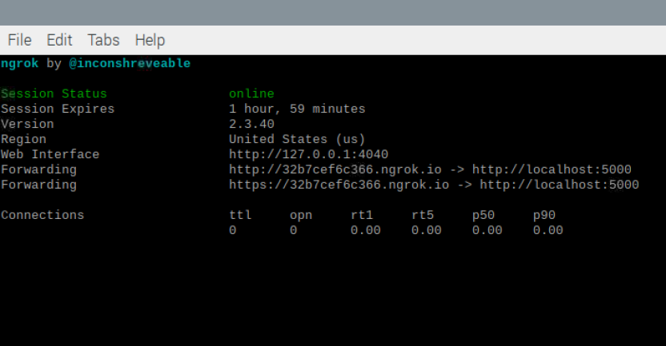
Starting HTTP tunnel on port 5000 using Ngrok
Run the below command to start the HTTP tunnel
./ngrok http 5000
This command opens up a new terminal which has a server link. i.e https://32b7cef6c366.ngrok.io. This link expiers in 2 hours. To get a new link after this expires, we have to run the above command again.

Slide 16
Installing Flask-ask and Cryptography libraires
Run the below commands to install Flask-ask and cryptography libraries
pip3 install Flask-Ask
pip3 install ‘cryptography<2.1’

Slide 17
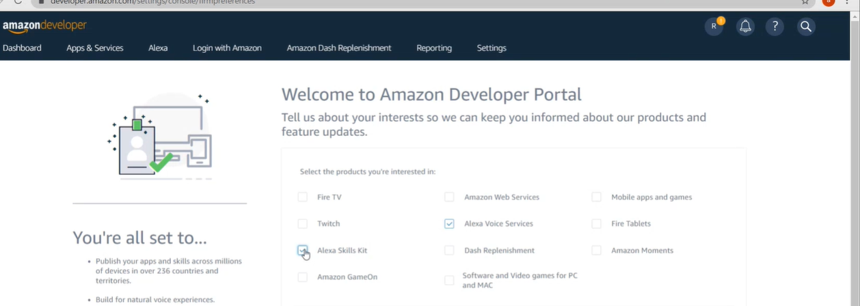
Signing up for Amazon developer account
Go to the URL:https://developer.amazon.com/
Click Sign-in and login with the credentials. Or create a new account using an email address.
Once signed it, we can select the products we are interested in. For this project we need ‘Alexa Voice Services and ‘Alexa skills kit’.

Slide 18
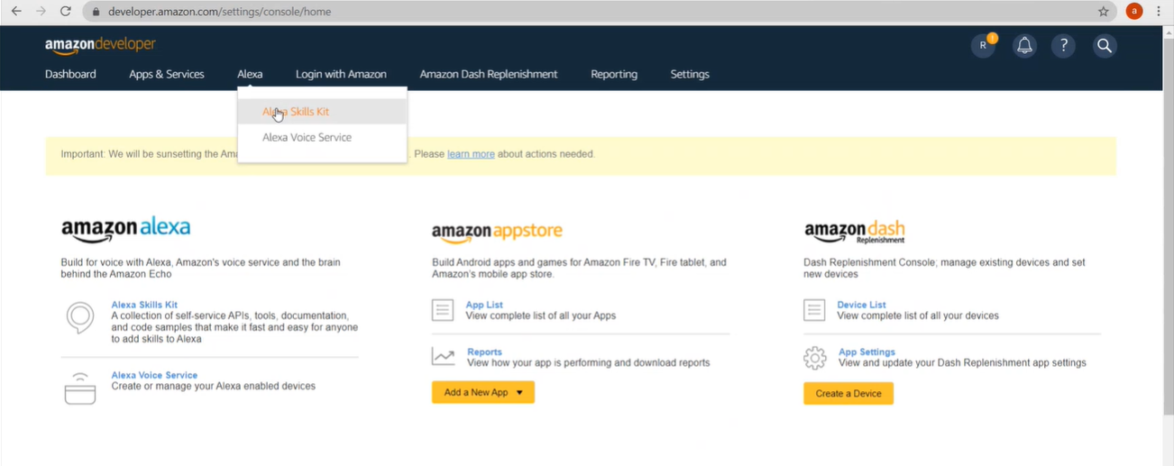
Configuring the skills kit
Once we have selected the required products and completed the previous step, the below screen will be displayed. Click Alexa and select ‘Alexa Skills Kit’.

Slide 19
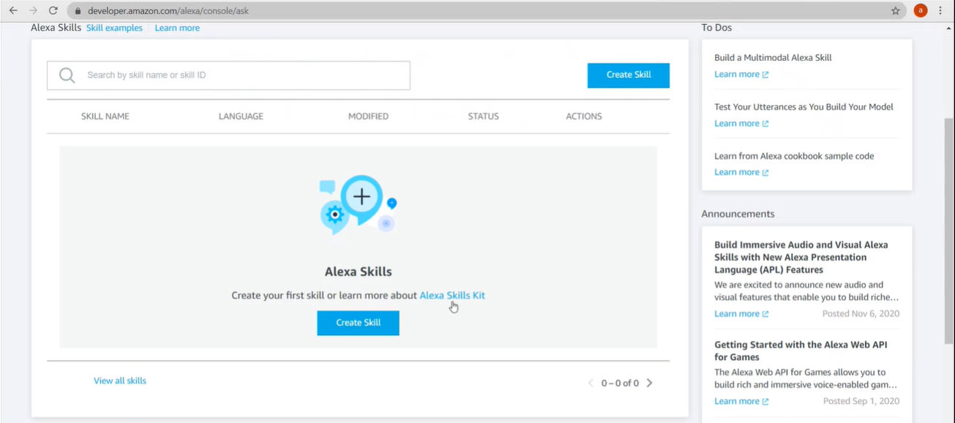
Configuring the skills kit
Next, we get a console for creating a skill.

Slide 20
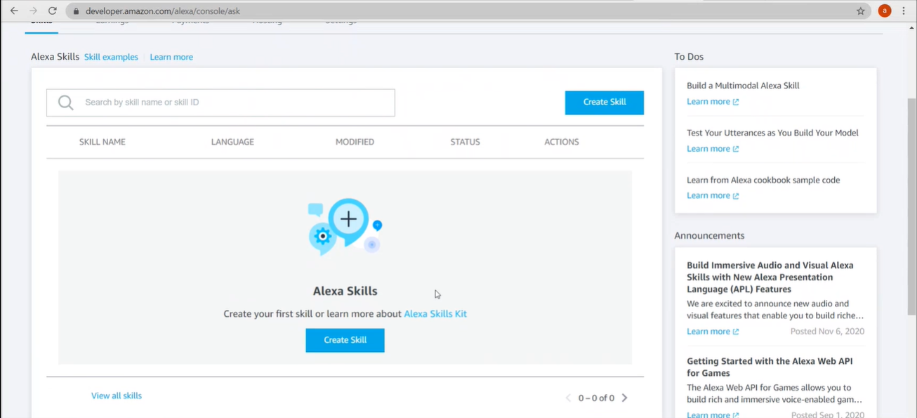
Configuring the skills kit
Create a new skill with name ‘Medicine Reminder’. Click on Create Skill in the below screen.

Slide 21
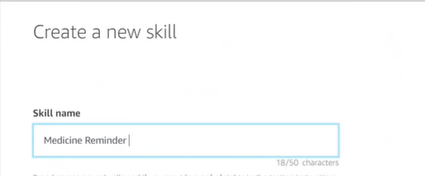
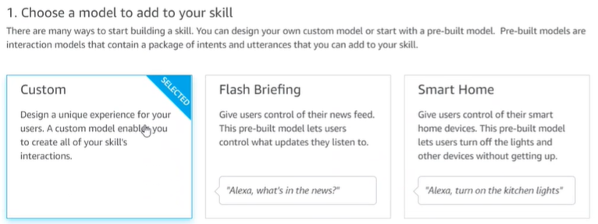
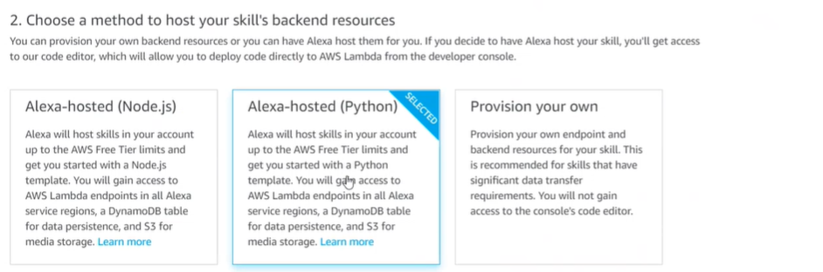
Configuring the skills kit

Slide 22
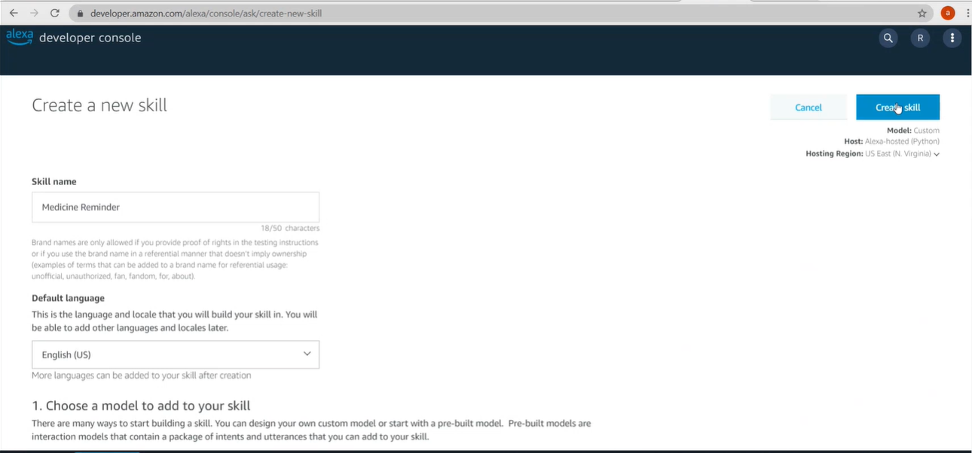
Configuring the skills kit

Slide 23
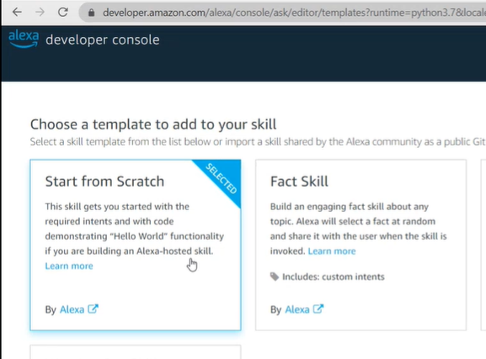
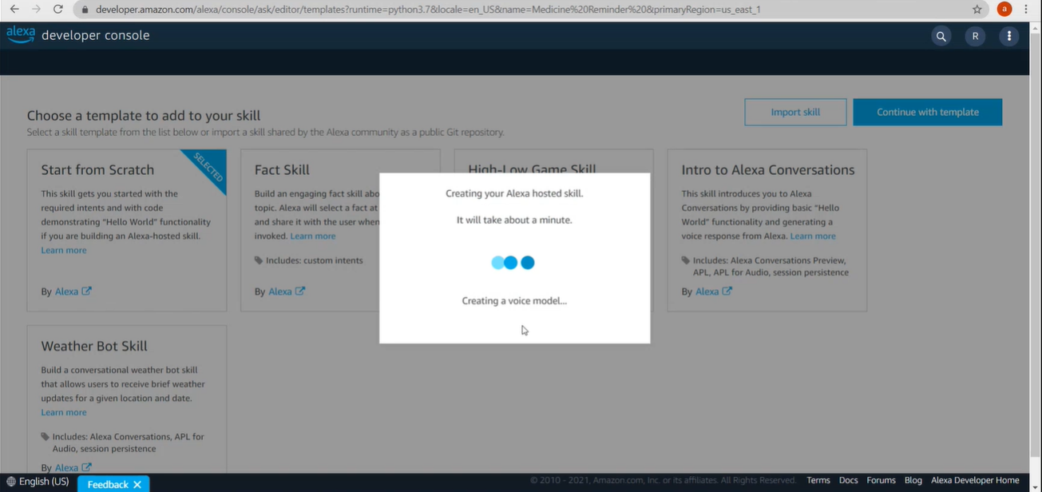
Configuring the skills kit

Slide 24
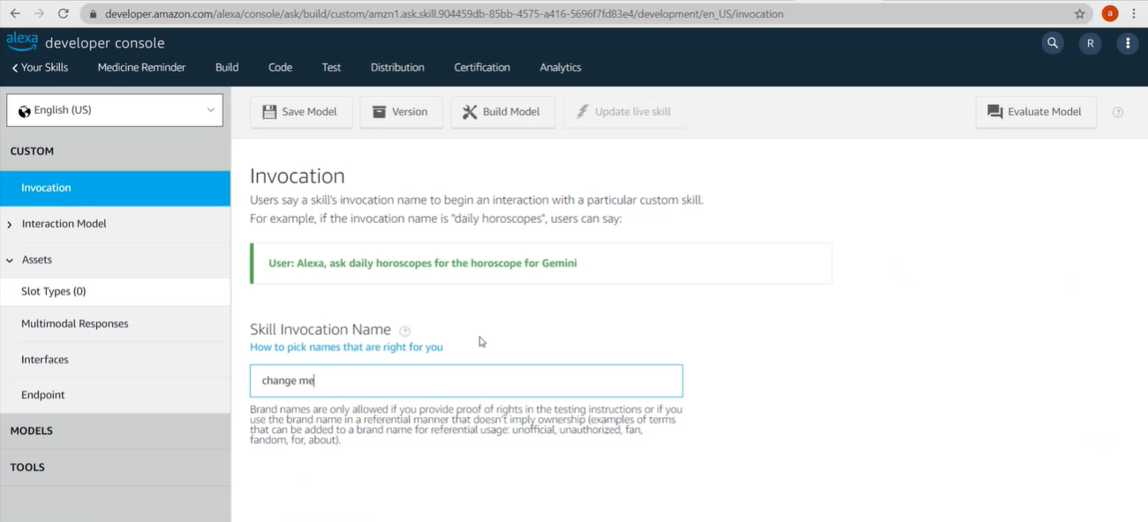
Configuring the skills kit
Give a invocation name ‘iron man’.

Slide 25
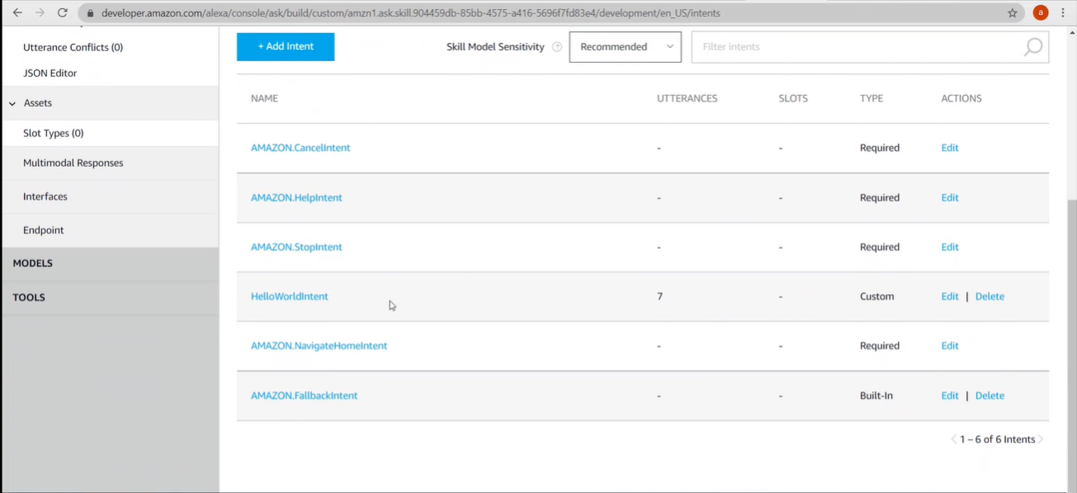
Configuring the skills kit
Adding intents: Intents: An intent represents an action that fulfills a user's spoken request. Intents can optionally have arguments called slots.Alexa skills kit already has 6 built-in intents

Slide 26
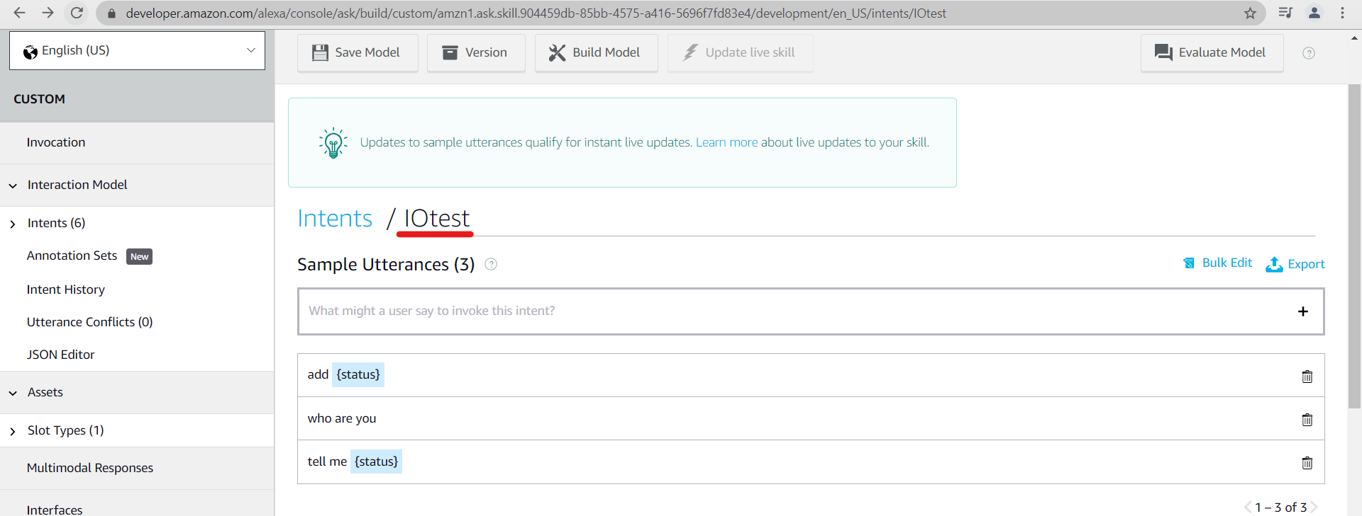
Configuring the skills kit
Create a custom intent with a name ‘IOtest’. And add sample utterances of what the user might ask ‘Alexa’.
Here two utterances are added: add {status} and tell me {status}

Slide 27
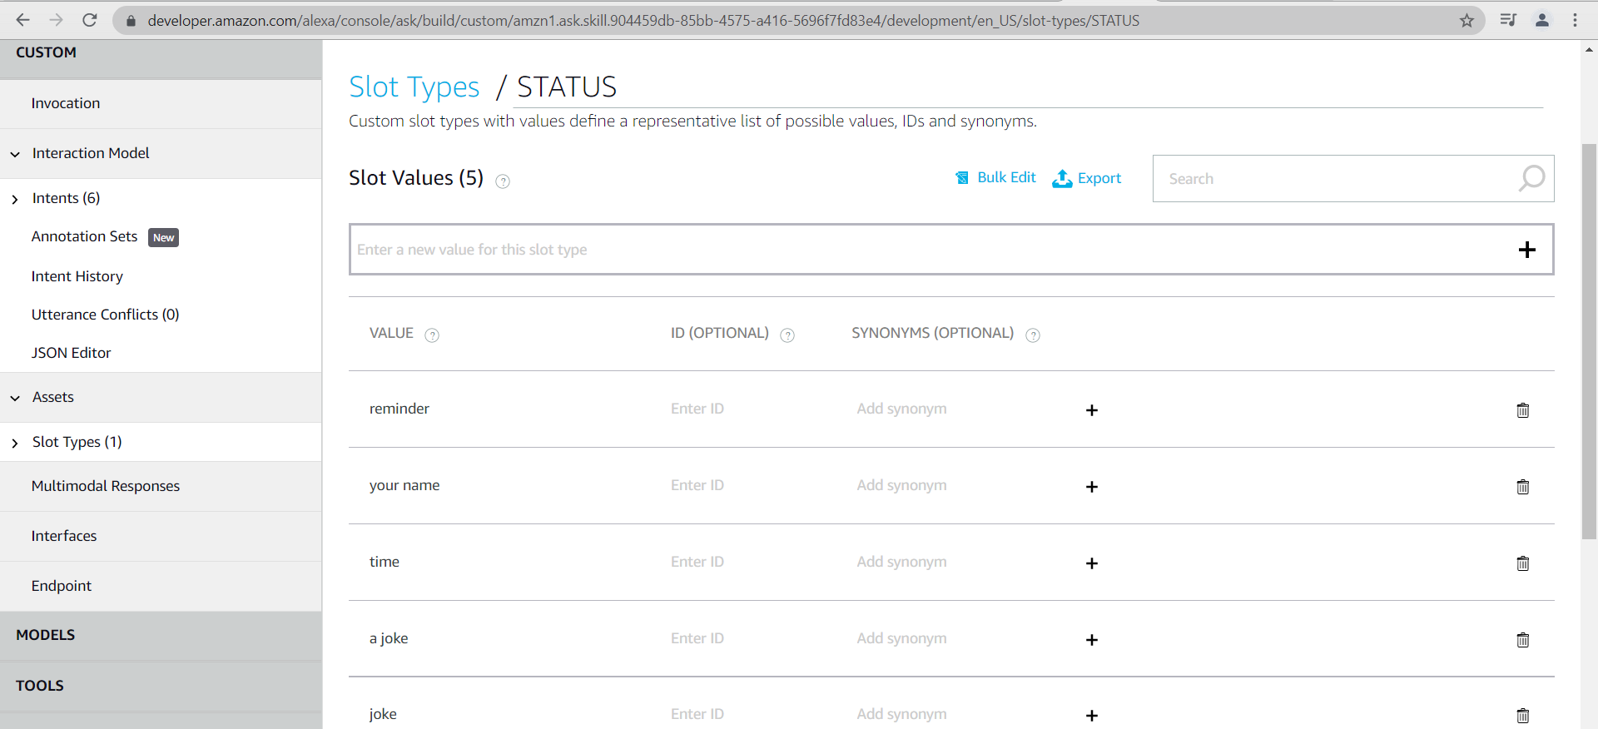
Configuring the skills kit
Adding Slot Type: The Alexa Skills Kit supports several slot types that define how data in the slot is recognized and handled. A new Slot Type with name as STATUS is added. To this we are adding values like ‘reminder’, ‘a joke’, ‘time’.

Slide 28
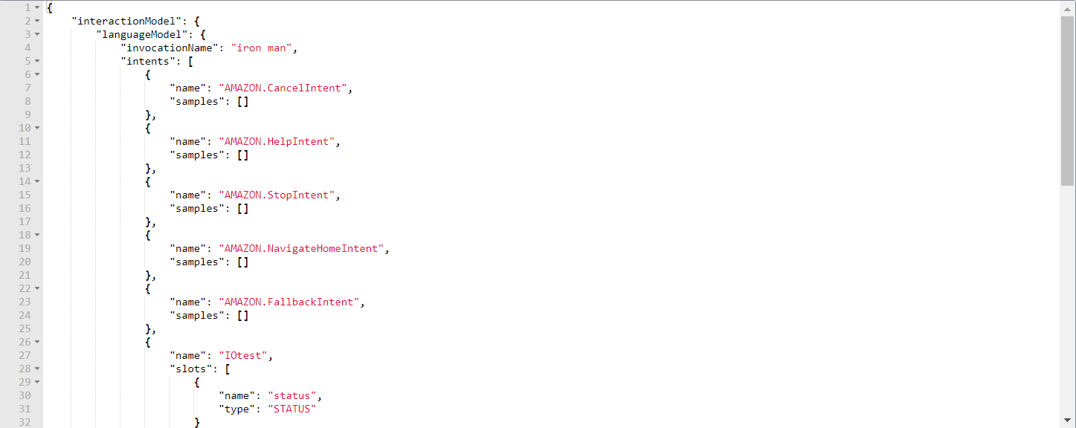
Configuring the skills kit
Adding JSON code in JSON editor: Intents are specified in JSON structure called intent schema.

Slide 29
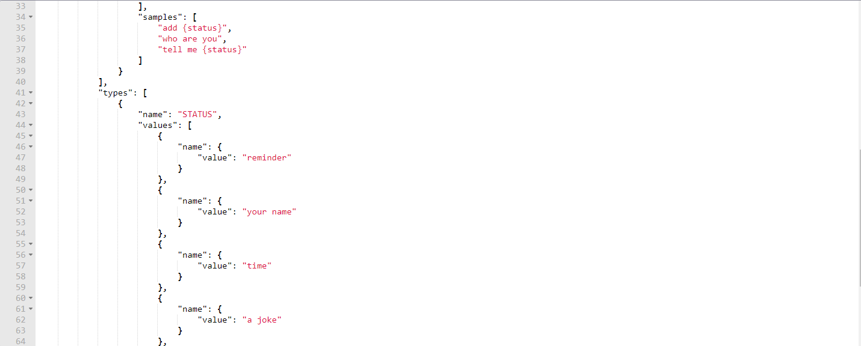
Configuring the skills kit

Slide 30
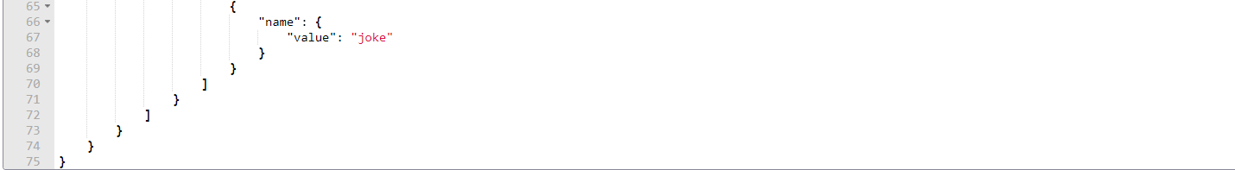
Configuring the skills kit

Slide 31
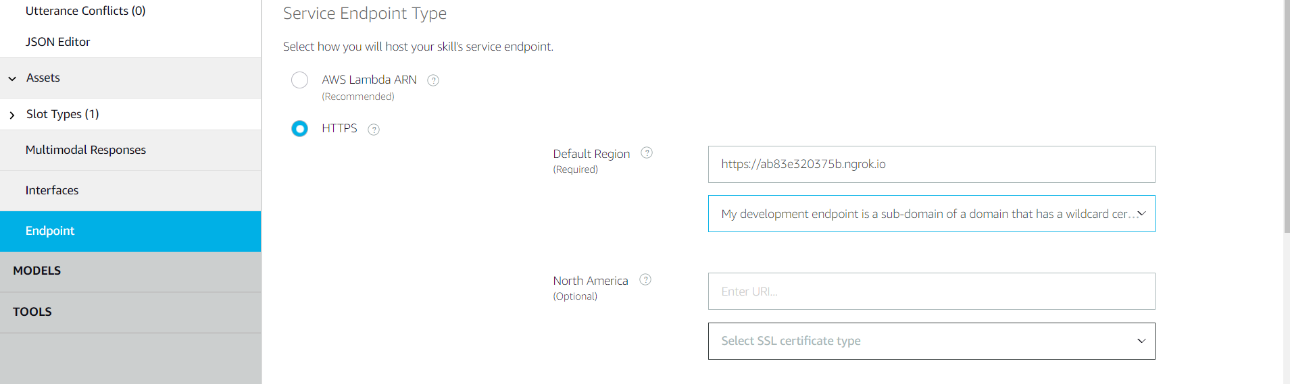
Configuring the skills kit
Adding an end point: An endpoint represents an Alexa-connected device (like an Echo device) with which an Alexa customer can interact. We give the http URL generated by Ngrok here and select 2nd option from the dropdown for SSL certificate type.

Slide 32
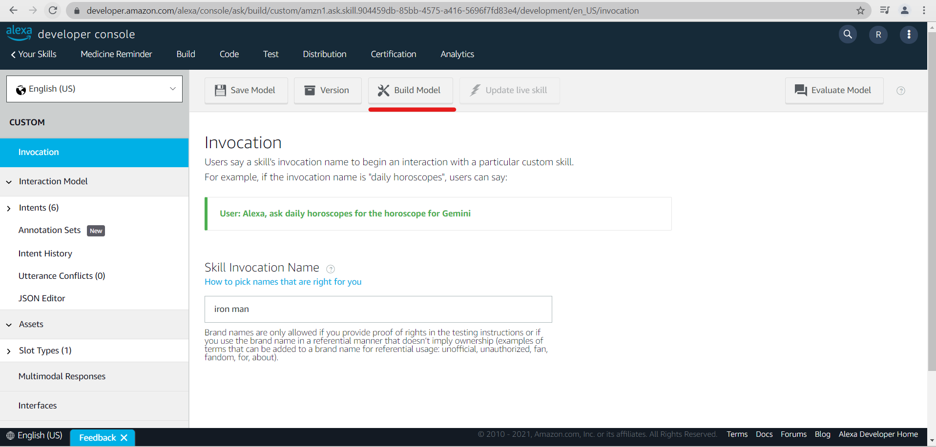
Configuring the skills kit
Save and build your model to start using the skill developed.

Slide 33
Coding the Raspberry pi using Python
Click Programming from Raspbian icon on the desktop and select Thony Python IDE to code the raspberry pi.
Below code is used to program the raspberry pi.

Slide 34
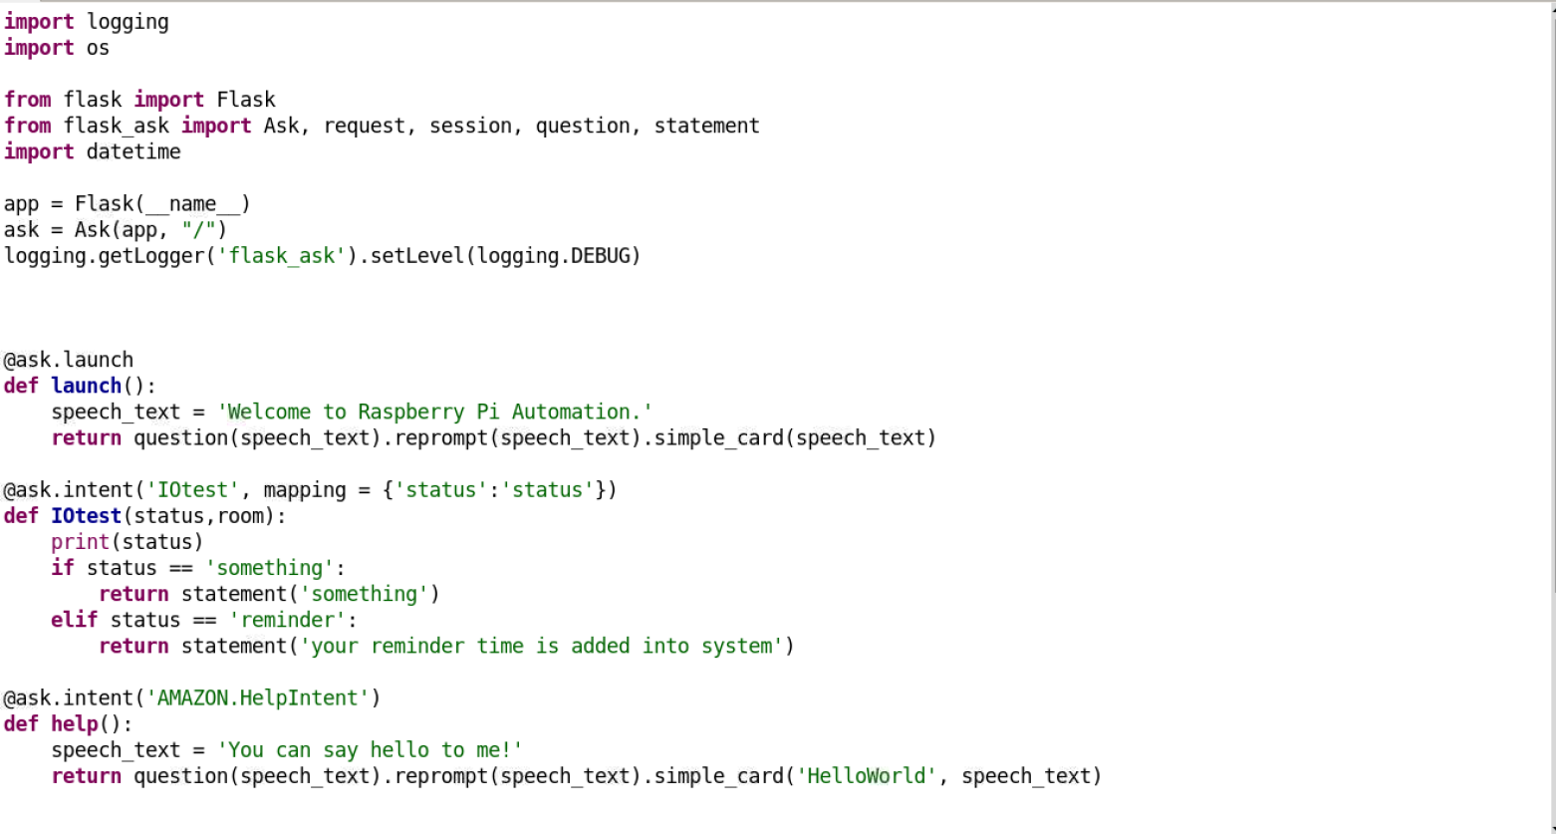
Coding the Raspberry pi using Python

Slide 35
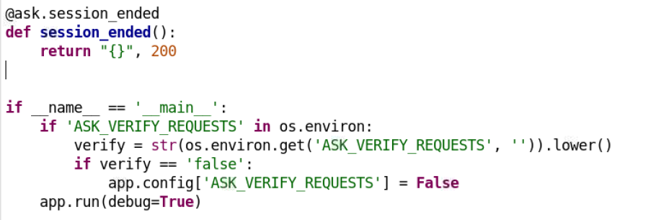
Coding the Raspberry pi using Python

Slide 36
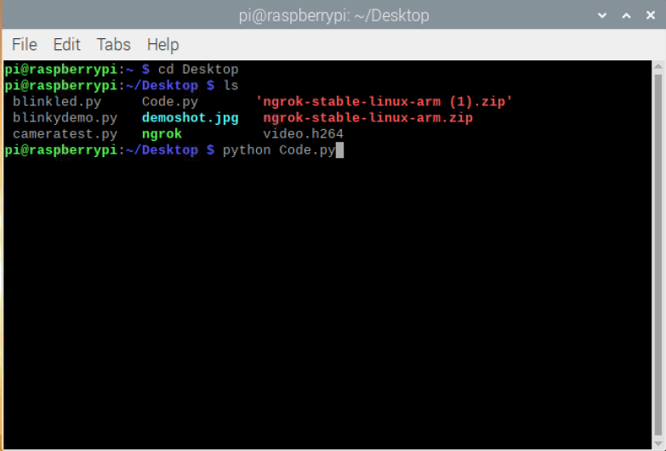
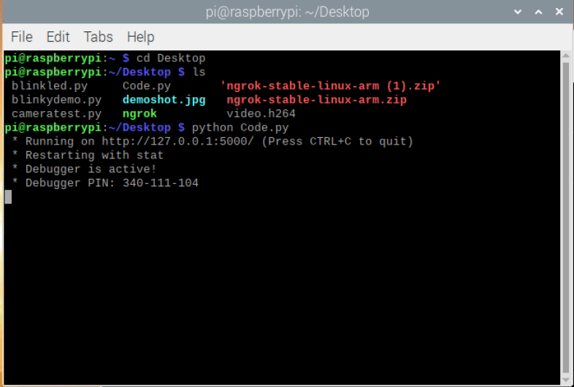
Working of the interface
Steps:
Run the python code from the terminal using the command python Code.py and hit enter. Code is active and running.

Slide 37
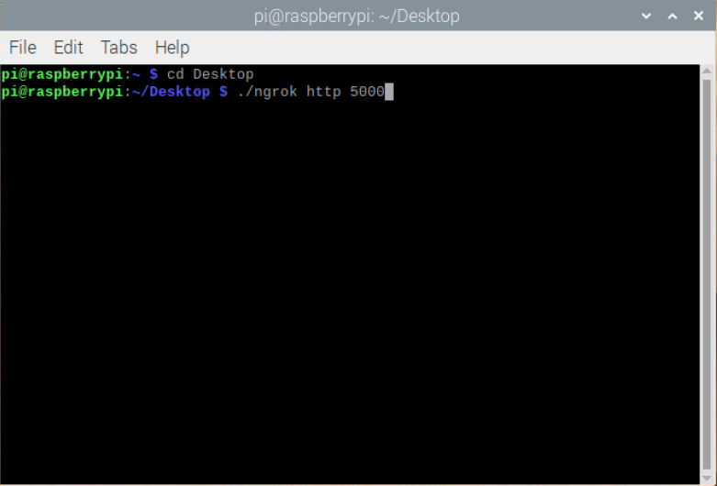
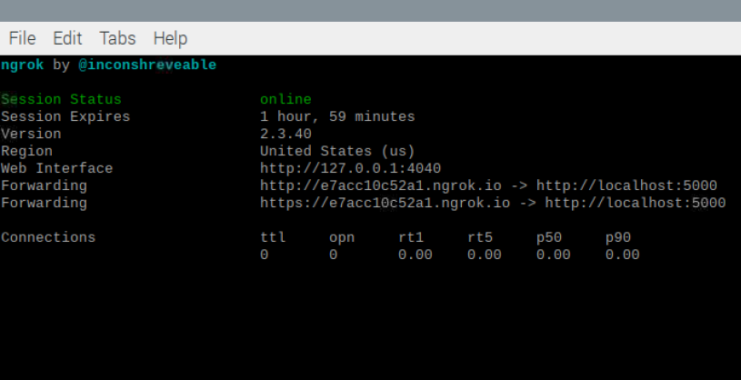
Working of the interface
2. Run the ngrok client to start the server in order to connect the raspberry pi to the amazon server using Endpoints. And the server link created is https://e7acc10c52a1.ngrok.io

Slide 38
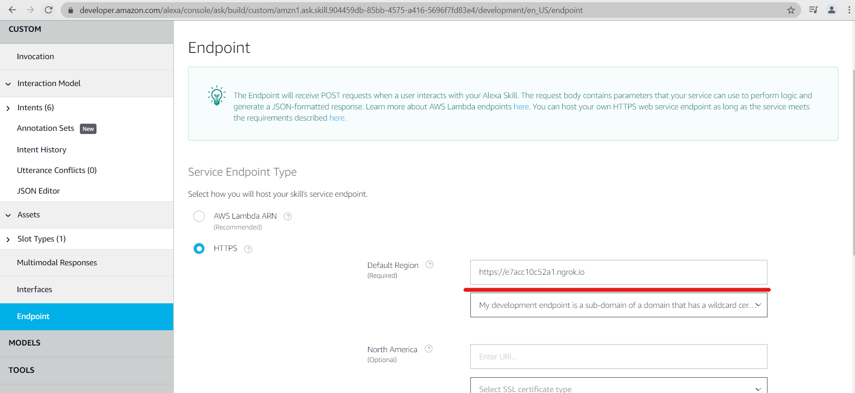
Working of the interface
3. Go to Amazon Developer Console, open the skill created and add the End point as the URL created by Ngrok.
https://e7acc10c52a1.ngrok.io

Slide 39
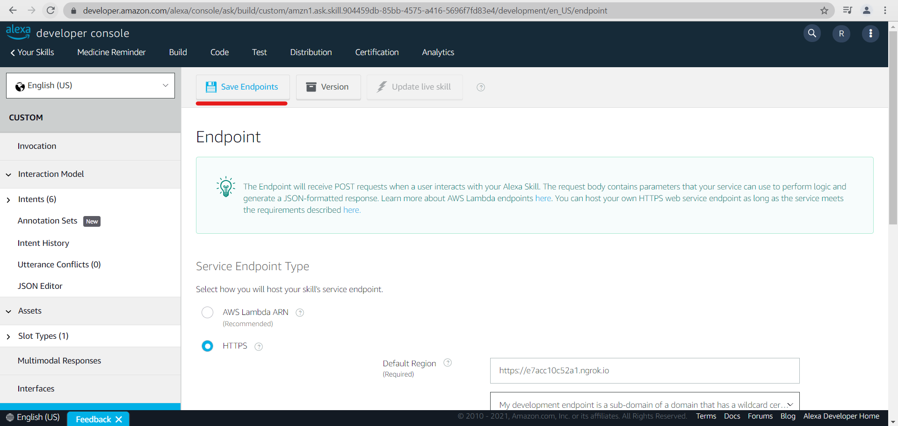
Working of the interface
4. Save End points.

Slide 40
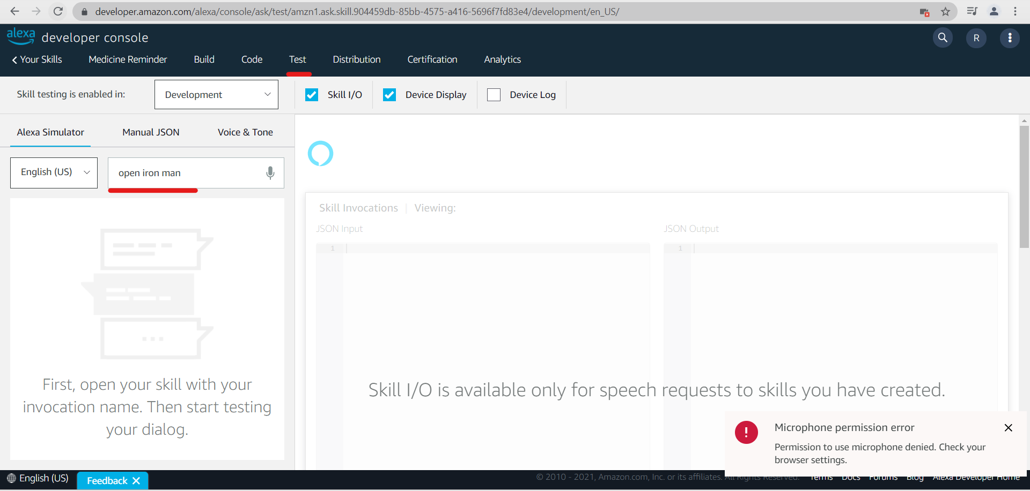
Working of the interface
5. Go to Test and type ‘open iron man’ which is the invocation name given. Hit enter

Slide 41
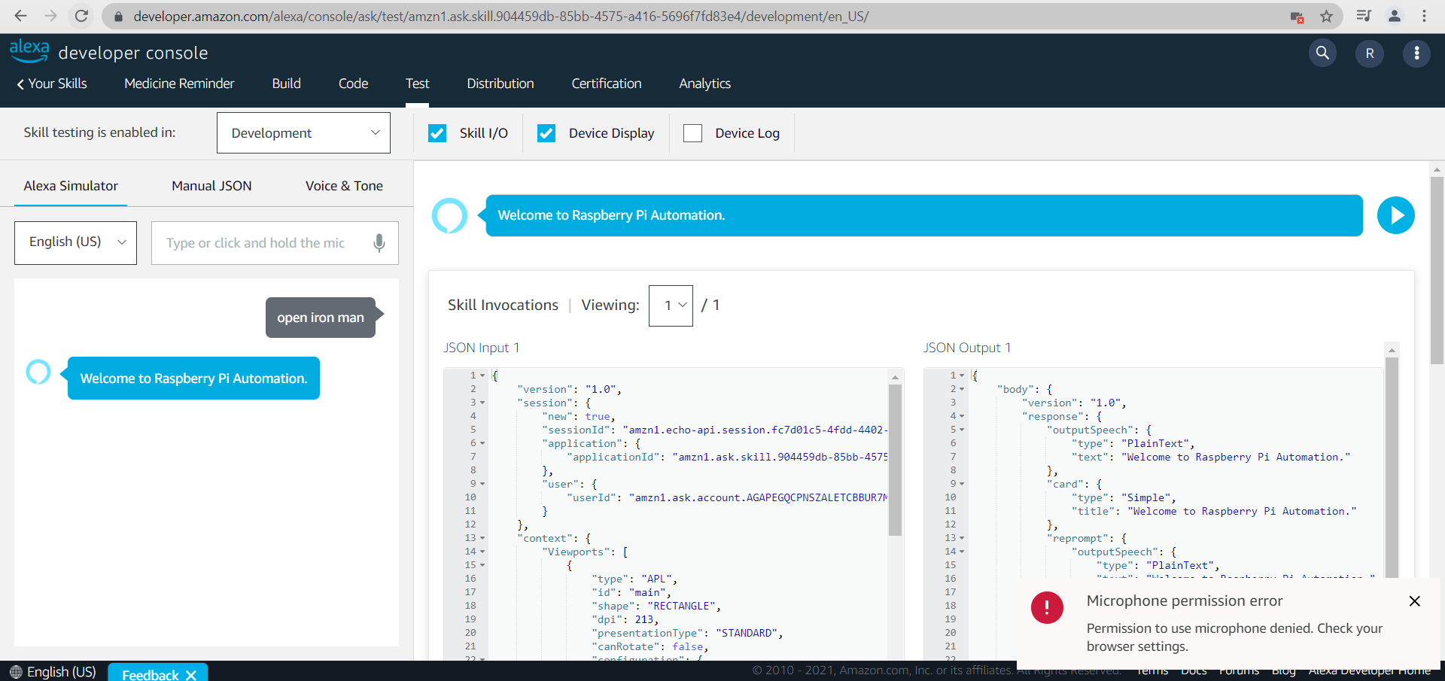
Working of the interface

Slide 42
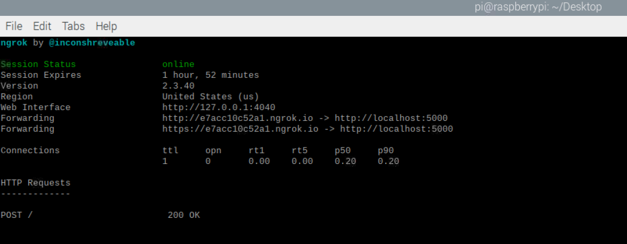
Working of the interface
6. Go to ngrok terminal and check the response

Slide 43
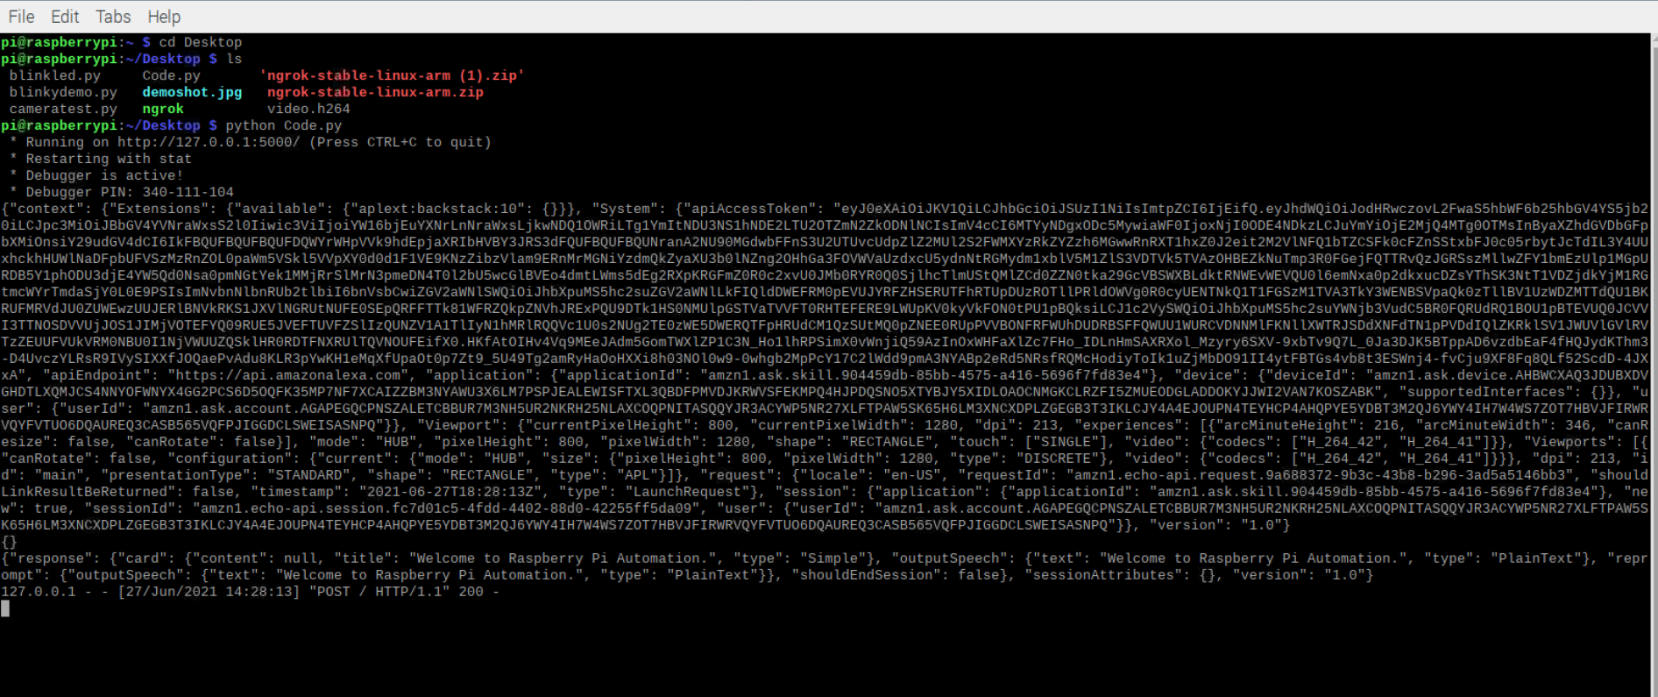
Working of the interface
7. Also, check the response on the terminal where code was executed. We received a response.

Slide 44
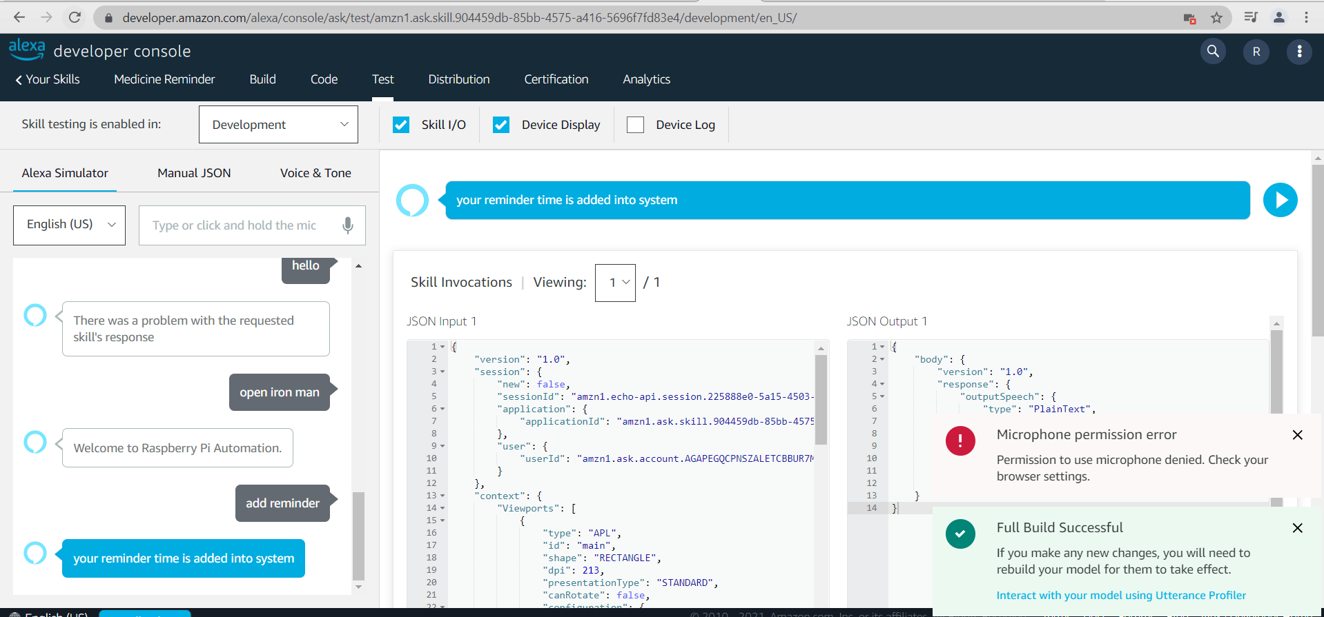
Working of the interface
8. Type or say “add reminder” for which it should reply “Your reminder time is added into system”.

Slide 45
References
AmazonDeveloper. (n.d.). Create the Interaction Model for Your Skill.
Retrieved from Alexa Developer Documentation: https://developer.amazon.com/en-US/docs/alexa/custom-skills/create-the-interaction-model-for-your-skill.html
AmazonDeveloper. (n.d.). Endpoint API.
Retrieved from Alexa Developer Documentation: https://developer.amazon.com/en-US/docs/alexa/alexa-smart-properties/alexa-for-residential-endpoint-api.html
AmazonDeveloper. (n.d.). Slot Type Reference.
Retrieved from Alexa Developer Documentation: https://developer.amazon.com/en-US/docs/alexa/custom-skills/slot-type-reference.html
Mandaji, S. (2021). alexa_skil_test/json_file.
Retrieved from GitHub: https://github.com/saikumar-mandaji/alexa_skil_test/blob/main/json_file
Ngrok. (n.d.). Download and Setup Ngrok.
Retrieved from ngrok: https://ngrok.com/download
Patel, N. (2018, May 30). Controlling Raspberry Pi Using Alexa.
Retrieved from hackster.io: https://www.hackster.io/nishit-patel/controlling-raspberry-pi-using-alexa-33715b
Ralevic, U. (2018, July 24). How To Build A Custom Amazon Alexa Skill, Step-By-Step: My Favorite Chess Player.
Retrieved from Crowdbotics: https://medium.com/crowdbotics/how-to-build-a-custom-amazon-alexa-skill-step-by-step-my-favorite-chess-player-dcc0edae53fb

